Slide 1

Accountability
Hasan Muhammad Baniamin

Slide 2
Accountability
Accountability can be defined as a social relationship in which an actor feels an
obligation to explain and to justify his or her conduct to some significant other.
Two key factors:
  Actor or accountor
  Significant other-accountability forum or accontee

Slide 3
Elements of an accountability system
The relationship between the actor and the forum, usually consists of at least three elements :
  First of all, the actor must feel obliged to inform the forum about his conduct
  Secondly, the information can prompt the forum to interrogate the actor and to question the adequacy of the information or the legitimacy of the conduct.
  Thirdly, the forum usually passes judgment on the conduct of the actor.

Slide 4
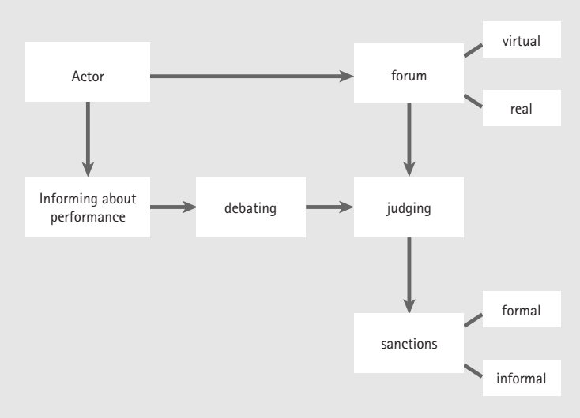
Accountability mechanisms

Slide 5
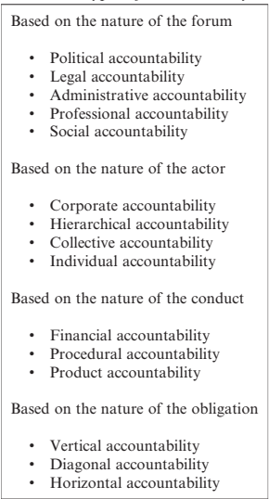
Types of accountability

Slide 6
Based on the nature of the forum
Political Accountability: Elected Representatives, Political Parties, Voters, Media
Legal Accountability: Courts
Administrative Accountability: Auditors, Inspectors and Controllers
Professional Accountability: Professional Peers
Social Accountability: Interest Groups, Charities and Other Stakeholders

Slide 7
Based on the nature of the actor
Corporate Accountability: The Organisation as Actor
Hierarchical Accountability: One for All (Minister for Ministry)
Collective Accountability: All for One (applicable for small public bodies).
Individual Accountability: Each for Himself

Slide 8
Based on the nature of the conduct
Financial-Efficiency, effectiveness and equity
Procedural- comply the existing procedural steps.
Product-labeling, date, elements etc.

Slide 9
Based on the nature of the obligation
Vertical accountability refers to the situation
where the forum formally wields power over the actor, perhaps due to the hierarchical
relationship between actor and forum
Horizontal accountability-mutual accountability between bodies standing on equal footing; it also consist the accountability to the general public.
Diagonal accountability-ombudsmen, audit offices which stand in no direct hierarchical relationship.

Slide 10
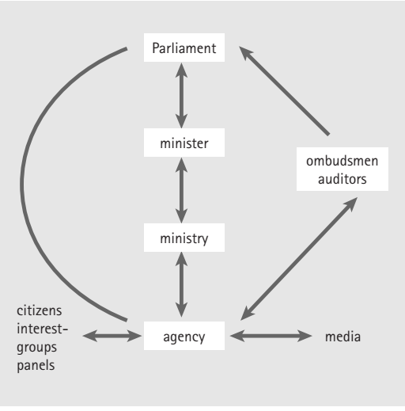
Based on the nature of the obligation
Vertical
Diagonal
Horizontal

Slide 11
Excess of Accountability
Accountably may be good but too much may generate problems- accountability dilemma or accountability paradox.
Rule-obsessed organizations turn the timid into cowards and the bold into outlaws.

Slide 12


Slide 13
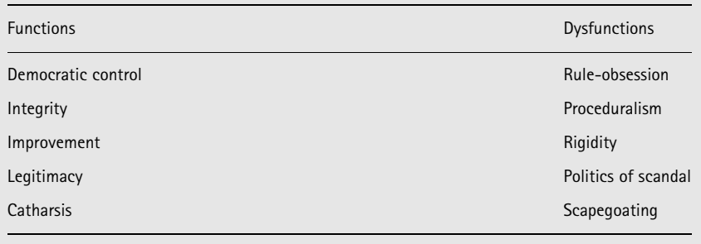
Functions and dysfunctions of public accountability Functions

Slide 14
Suggested readings
Bovens, M. (2007). Analysing and assessing accountability: A conceptual framework 1. European law journal, 13(4), 447-468.
Bovens, M. (2014). Public accountability, Chapter 8. in Bovens, M., Schillemans, T., & Goodin, R. E. (2014). Public accountability. The Oxford handbook of public accountability.
Busuioc, M. (2020). Accountable Artificial Intelligence: Holding Algorithms to Account. Public Administration Review. Url: https://onlinelibrary.wiley.com/doi/10.1111/puar.13293

Slide 15
Q?

